Slide 1
Restaurant Recommending Chatbot
Week
4
Weekly Report - Group 3
Murali Krishna(C0794253)
Swathi Gurijala(C0790294)
Varadharajan Kalyanaraman(C0793756)
Vignesh Kumar Murugananthan(C0793760)

Slide 2
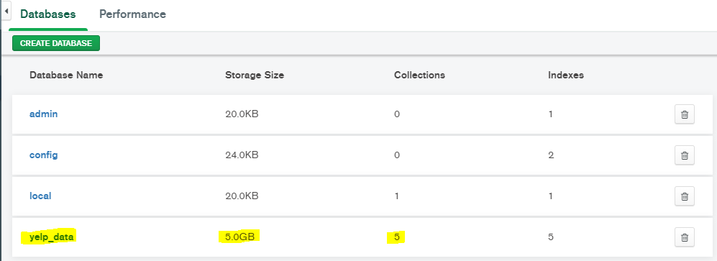
Data Set - Yelp
MongoDB Compass

Slide 3
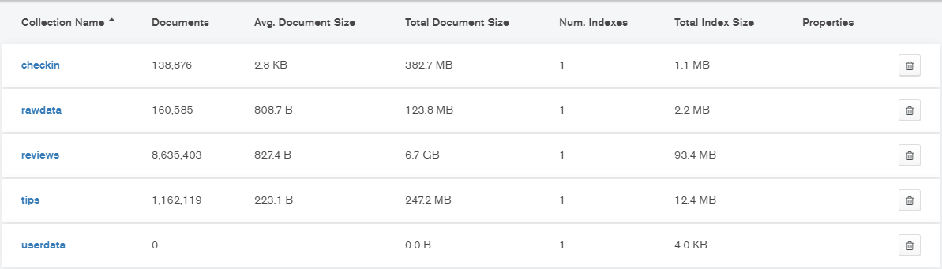
Json Files imported

Slide 4
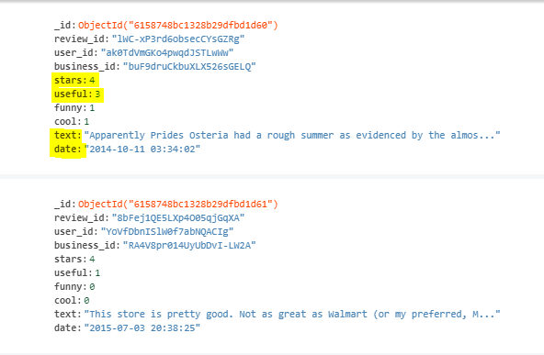
Review data sample

Slide 5
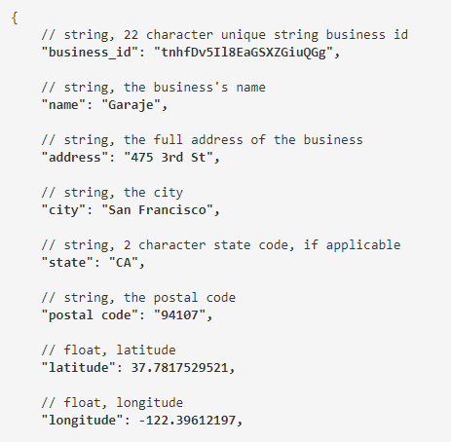

Slide 6
Next week work - Week 4
Perform initial cleaning of data.
Data Preprocessing.
Structure the data.

Slide 7
Restaurant Recommending Chatbot
Week
5
Weekly Report - Group 3
Murali Krishna(C0794253)
Swathi Gurijala(C0790294)
Varadharajan Kalyanaraman(C0793756)
Vignesh Kumar Murugananthan(C0793760)

Slide 8
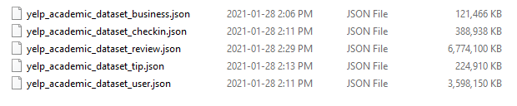
Week 5 - Dataset review :

Slide 9
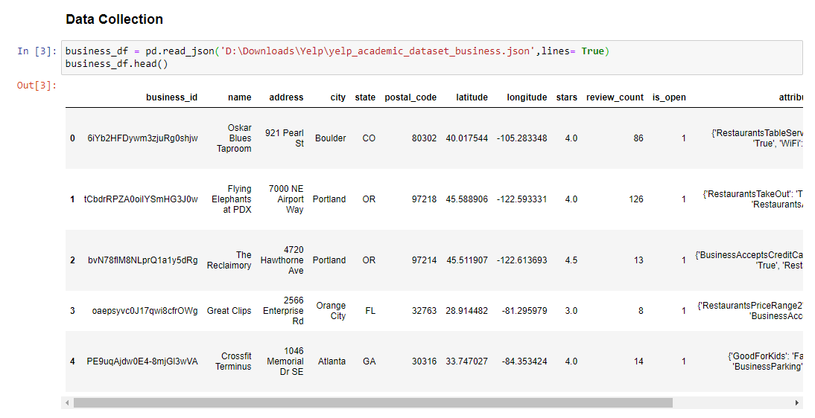
Data Collection : Business Dataset

Slide 10
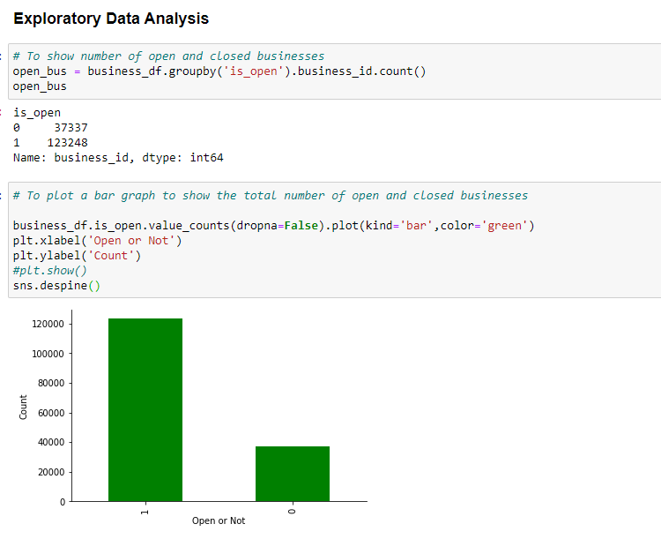
Exploratory Data Analysis

Slide 11
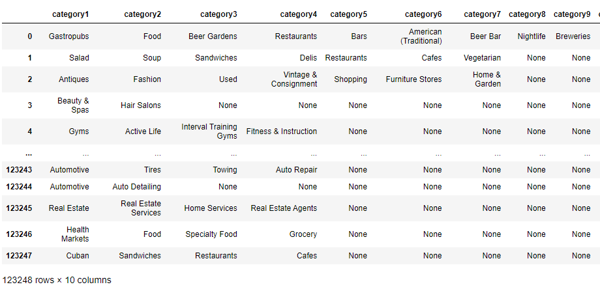
Restaurant Category

Slide 12
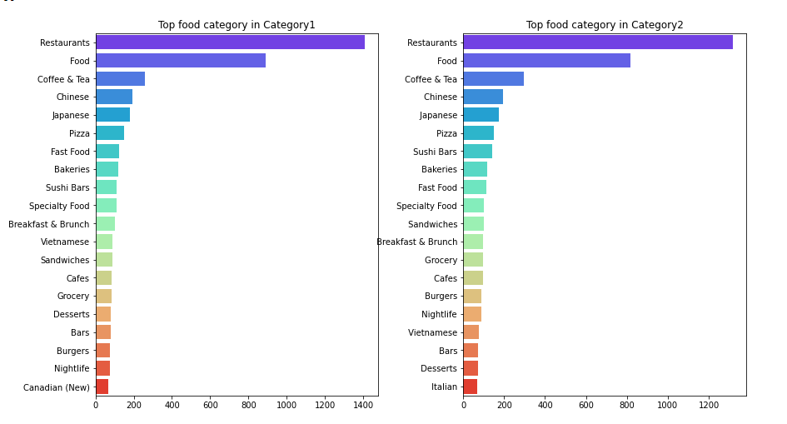
Category 1 vs Category 2

Slide 13
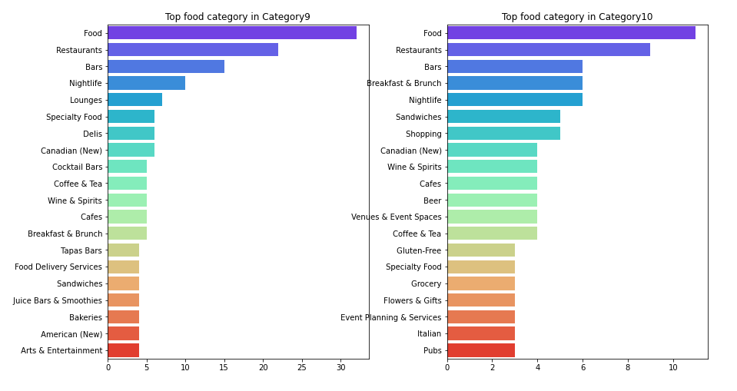
Category 9 vs Category 10

Slide 14
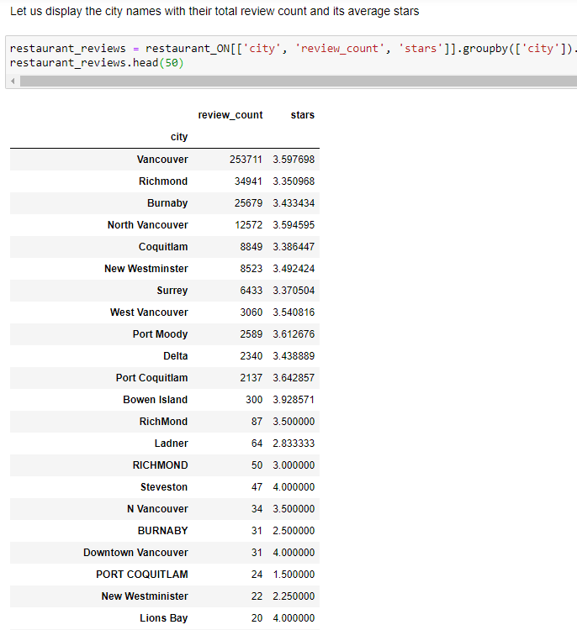
Reviews on each City:

Slide 15
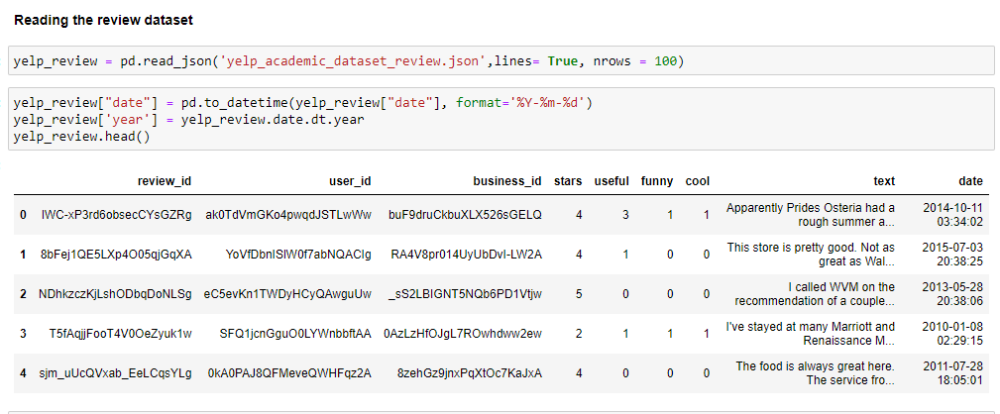
Review Dataset

Slide 16
Upcoming works:
NLP Concepts - Finding the best restaurants for particular cuisines
Modelling
Model Evaluation
Cosine Similarity
Chat bot Building

Slide 17
Thank You

Slide 18
Restaurant Recommending Chatbot
Week
7
Weekly Report - Group 3
Murali Krishna(C0794253)
Swathi Gurijala(C0790294)
Varadharajan Kalyanaraman(C0793756)
Vignesh Kumar Murugananthan(C0793760)

Slide 19

Training the dataset with multiple Algorithms

Slide 20
Modelling

Slide 21
Training Evaluation

Slide 22
Scores - Evaluation

Slide 23
Evaluating the Test data

Slide 24
Evaluating the Test Data

Slide 25
Azure Services

Slide 26
Azure Cognitive QnA Bot Service- Training Data.

Slide 27
Sample QnA Bot.

Slide 28
Input city

Slide 29
Input Cuisine

Slide 30
Results

Slide 31
Restaurant Recommending Chatbot
Week
7
Weekly Report - Group 3
Murali Krishna(C0794253)
Swathi Gurijala(C0790294)
Varadharajan Kalyanaraman(C0793756)
Vignesh Kumar Murugananthan(C0793760)

Slide 32
Azure Services
QnA Maker
Knowledge base
Chat Bot cognitive service.

Slide 33
Knowledge Base

Slide 34
Chatbot UI

Slide 35
Roadblocks and ToDo’s..
Roadblock:
Azure services are consuming more charges.
ToDo’s:
Complete integration (this week)

Slide 36
Restaurant Recommending Chatbot
Week
7
Weekly Report - Group 3
Murali Krishna(C0794253)
Swathi Gurijala(C0790294)
Varadharajan Kalyanaraman(C0793756)
Vignesh Kumar Murugananthan(C0793760)

Slide 37
Chatbot UI

Slide 38
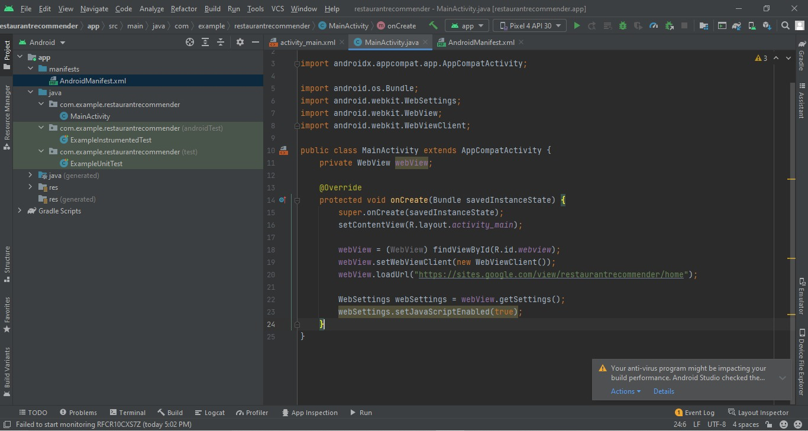
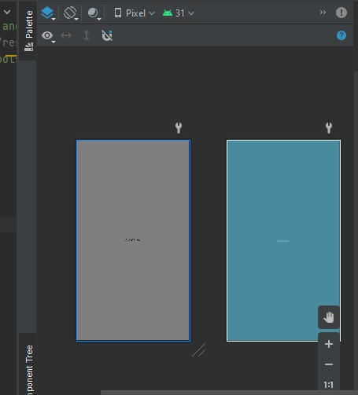
Android App creation

Slide 39

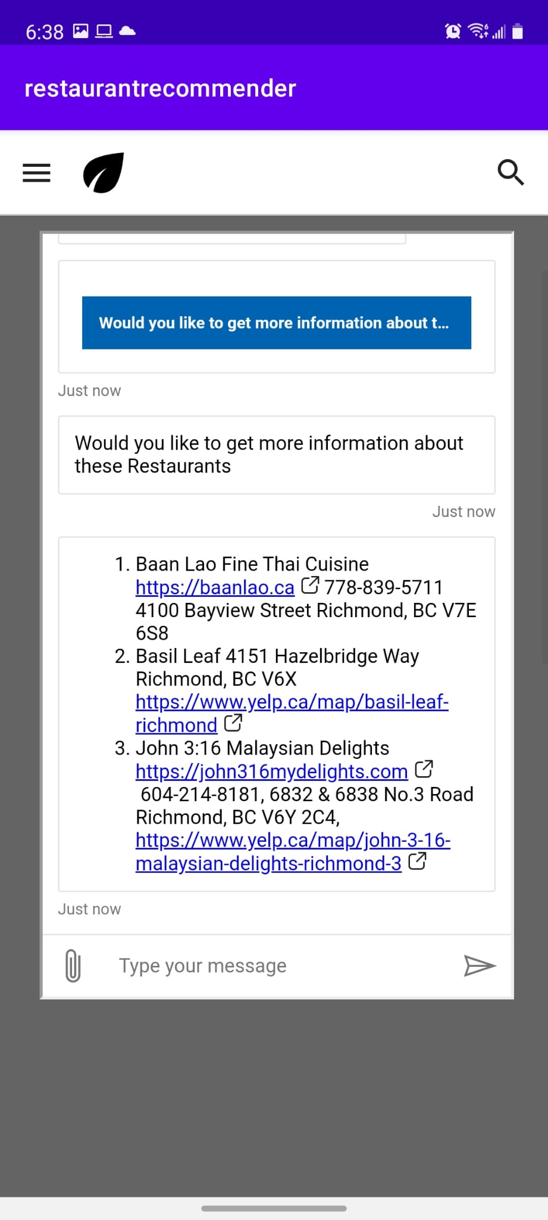
Issues faced in Android Studio and Cloud
HAXM Emulator issue.
Cloud service going to expire.
App Creation Bugs.
Bundling issues.
Knowledge base.

Slide 40
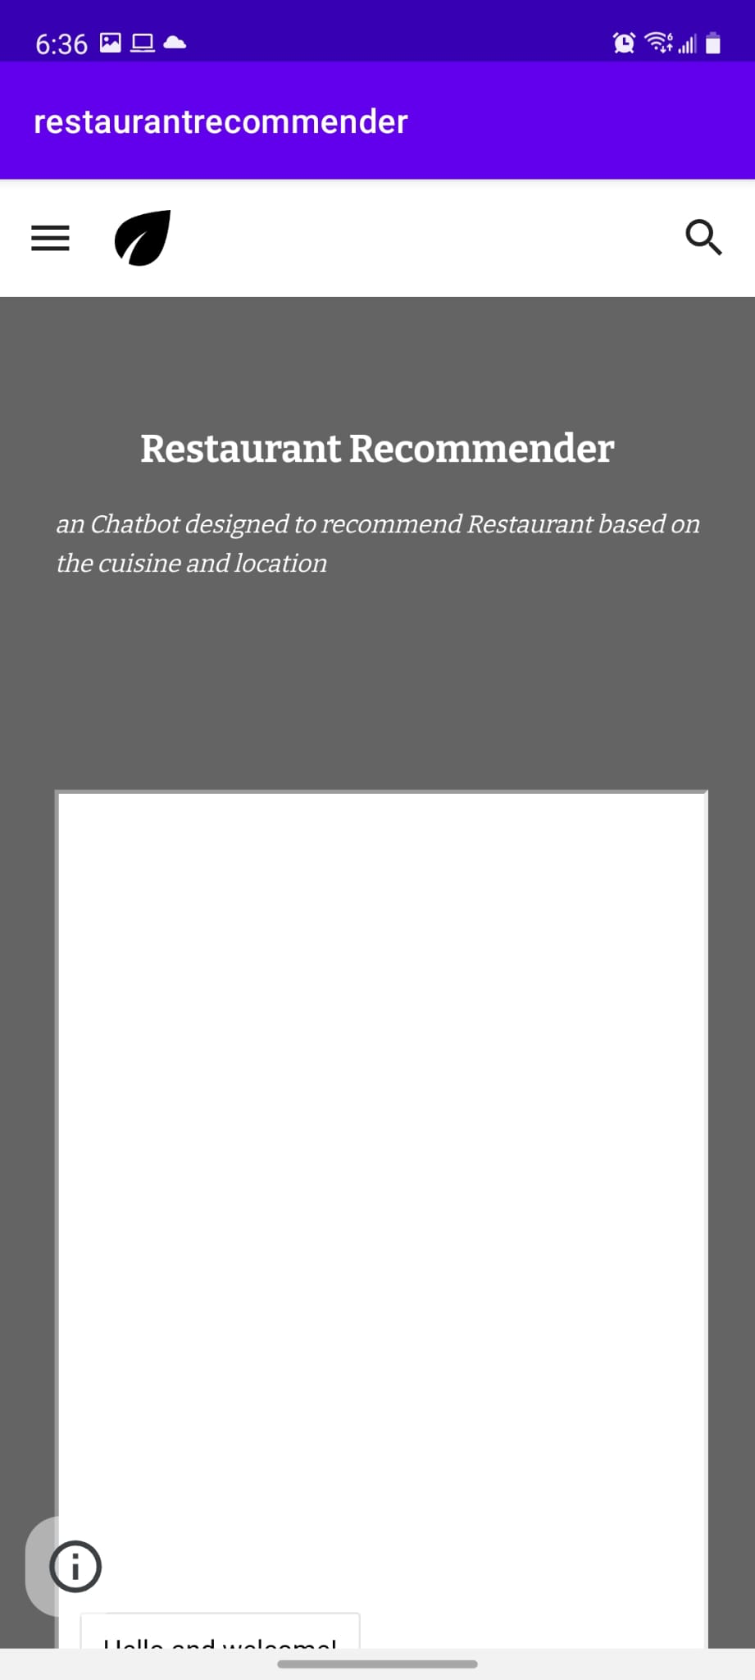
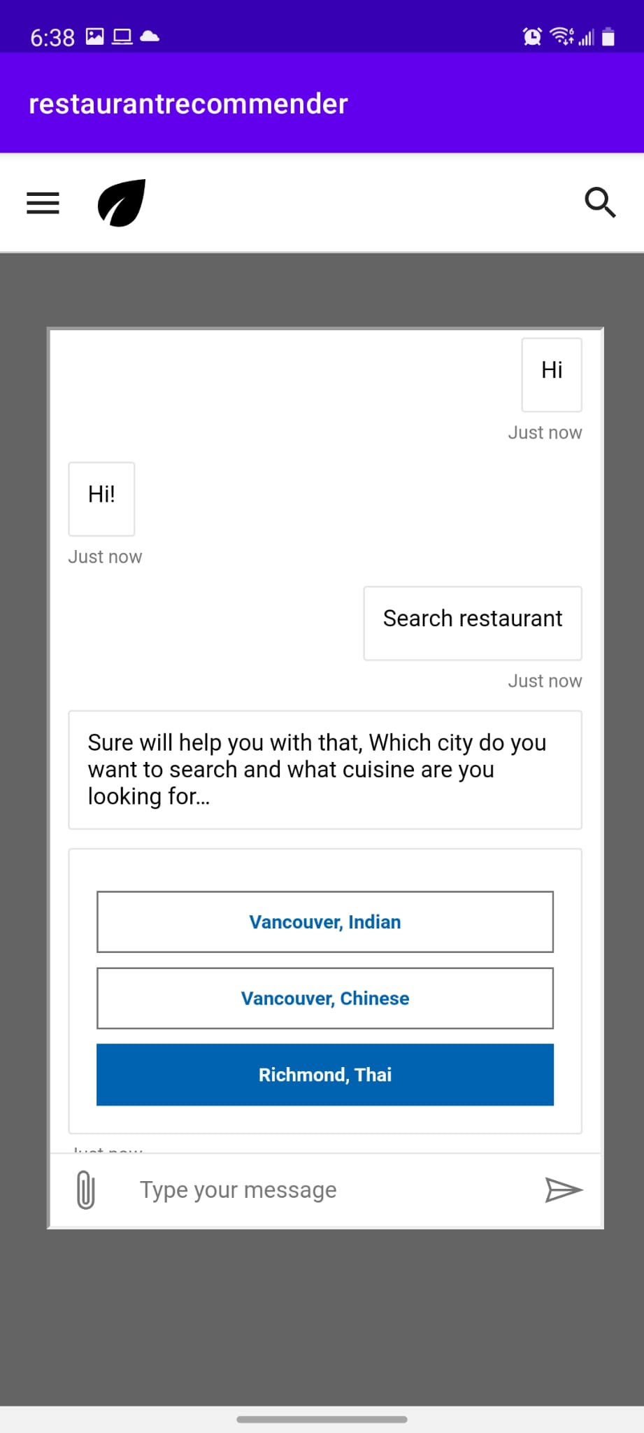
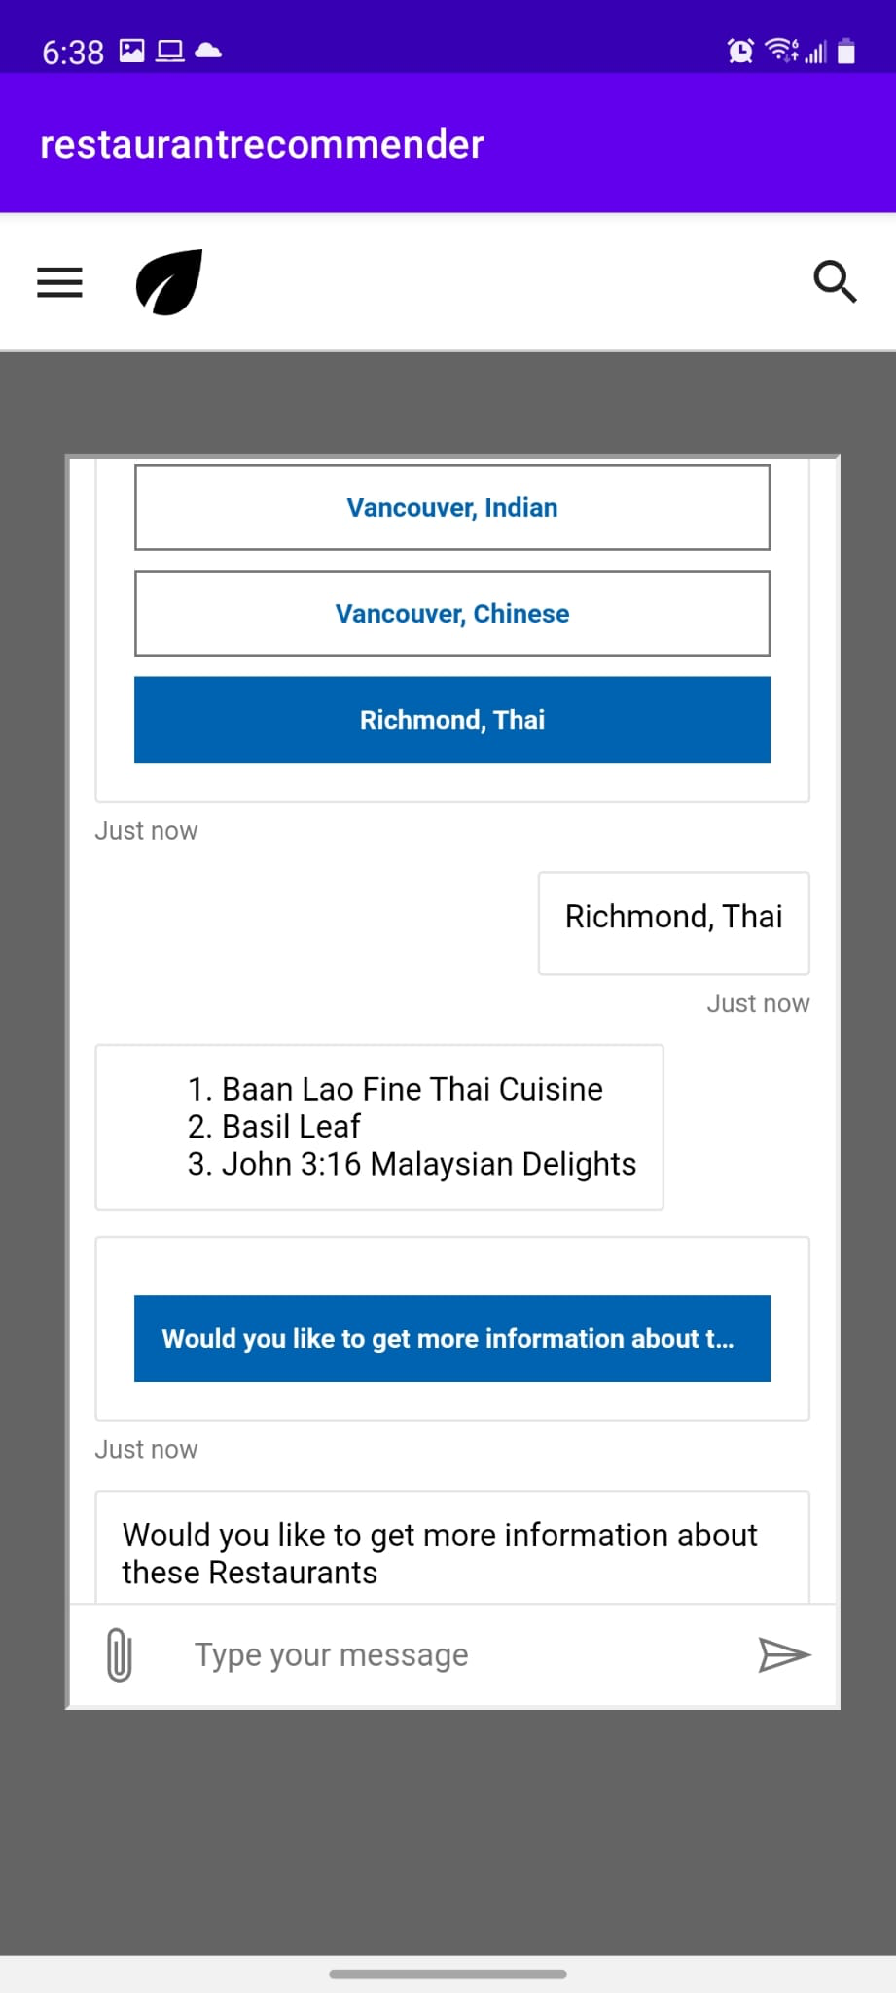
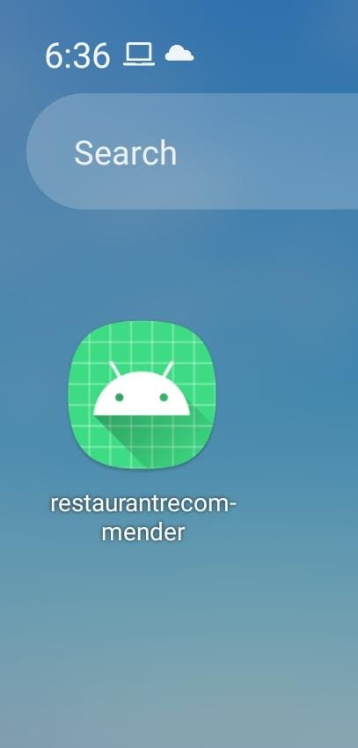
Android App

Slide 41
Restaurant Recommending Chatbot
Week
7
Weekly Report - Group 3
Murali Krishna(C0794253)
Swathi Gurijala(C0790294)
Varadharajan Kalyanaraman(C0793756)
Vignesh Kumar Murugananthan(C0793760)

Slide 42
Tasks Done and InProgress
Integration Completed
Final Testing Done
Android app Built completed.
All Bugs resolved.
Improved Chatbot Responses.
Started with Reports and Slides creation.

Slide 43
Future Improvements – on Large scale
Create Ubiquitous chatbot application
Map Integration for Navigation
Faster results and implement Batch processing
Include more information about restaurants like amenities, open hours, etc.

Slide 44
Thanks

